Slide 1

Android Text Encryption
by
Under the Guidance of
Prof. Monali Korde
Ritik Pandey (22106054)
Om Panchal (22106025)
Krishna Mishra (22106131)
Sumedh Gadpayle (22106076)

Slide 2
Outline
Introduction
Literature Survey of the existing systems
Limitations of the existing systems
Problem statement
System Design
Technologies and methodologies
Implementation
Conclusion
References

Slide 3
Introduction
Current Vulnerability:
  Users communicate over social media platforms.
  Messages are not secured during transmission over the network.
  Intruders can easily access and intercept user messages.
Encryption Process:
  The system uses the selected algorithm and key to encrypt the plain text.
  A cipher text is generated, representing the secured message.
Decryption Process:
  Receiver uses the same system to decrypt the received cipher text.
  Receiver selects the same algorithm used for encryption.
Android Studio and Java Implementation:
  Implemented using Android Studio and Java.
  Compatible with Android devices, ensuring widespread accessibility.

Slide 4
Objective
Data Security:
  Ensure that user messages are transmitted securely over the network.
  Guard against unauthorized access and interception of sensitive information.
  Secure user communication over all social media platforms.
Algorithm Flexibility:
  Support encryption algorithms such as AES giving users the flexibility to choose the level of security they prefer.
  Allow users to customize their encryption process based on their specific needs and preferences.
User-Friendly Encryption:
  Develop a user-friendly application that allows users to easily input plain text, choose encryption algorithms, and provide secret keys.
  Make the encryption and decryption process accessible to users without requiring extensive technical knowledge.

Slide 5
Problem statement
Vulnerability of Text Communication: Messages sent over Android devices lack encryption, leaving them open to interception by unauthorized parties, threatening user privacy and data security
Algorithm Selection and Key Management: Choosing appropriate encryption algorithms and securely managing encryption keys are crucial challenges. Algorithms must be strong yet efficient, while keys need secure generation, storage, and exchange, especially in multi-user scenarios.
User Interface Design and Performance Optimization: Designing a user-friendly interface is essential for user adoption, while optimizing performance to minimize resource consumption on mobile devices is a significant challenge.

Slide 6
Literature Survey
SR NO. | HEADLINE | AUTHOR | IMPLEMENTED
1. | Advanced Encryption Standard (AES) Algorithm to Encrypt and Decrypt Data | Ako Muhamad Abdullah | AES is a widely-used symmetric block cipher algorithm known for its robust security. It supports key sizes of 128, 192, and 256 bits with a fixed block size of 128 bits. Despite extensive use, there's no evidence of successful hacking attempts. This paper provides an overview of AES, its features, and compares it with other algorithms like DES, 3DES, and Blowfish.

Slide 7
Literature Survey
Sr.no | HEADLINE | AUTHORS | IMPLEMENTED
2. | File Encryption, Decryption Using AES Algorithm in Android Phone | Suchita Tayde , Asst. Prof. Seema Siledar | Smartphones and tablets offer extensive functionality but face security concerns. Encryption, vital for data security, is often limited by small key sizes or slower processes in algorithms like DES and 3DES. The Advanced Encryption Standard (AES) addresses these issues, providing both security and speed, making it ideal for mobile devices. This Android app allows users to encrypt various file types using AES for enhanced data security.

Slide 8
Literature Survey
Sr.no | HEADLINE | AUTHORS | IMPLEMENTED
3. | FPGA implementation of AES encryption and decryption | AshwinM. Deshpande, Mangesh S. Deshpande | This paper explores implementing the AES algorithm on Field Programmable Gate Arrays (FPGAs) using VHDL. It leverages ModelSim SE PLUS 5.7g for simulation and Xilinx ISE 8.2i suite for synthesis and implementation. The approach aims to optimize hardware usage while maintaining high data rates for encryption and decryption. By integrating encrypter and decrypter modules, the architecture achieves low complexity, making it suitable for hardware-critical applications like smart cards and mobile phones.

Slide 9
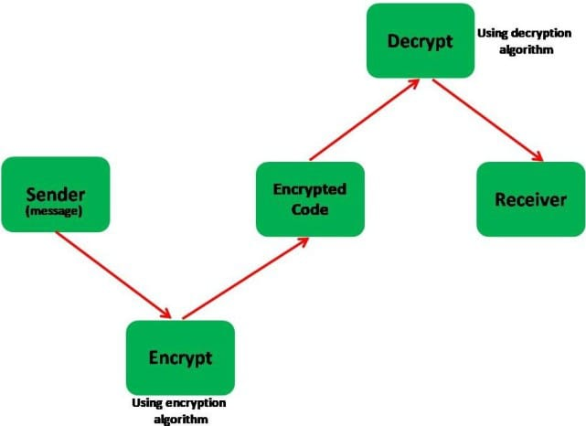
System Design

Slide 10
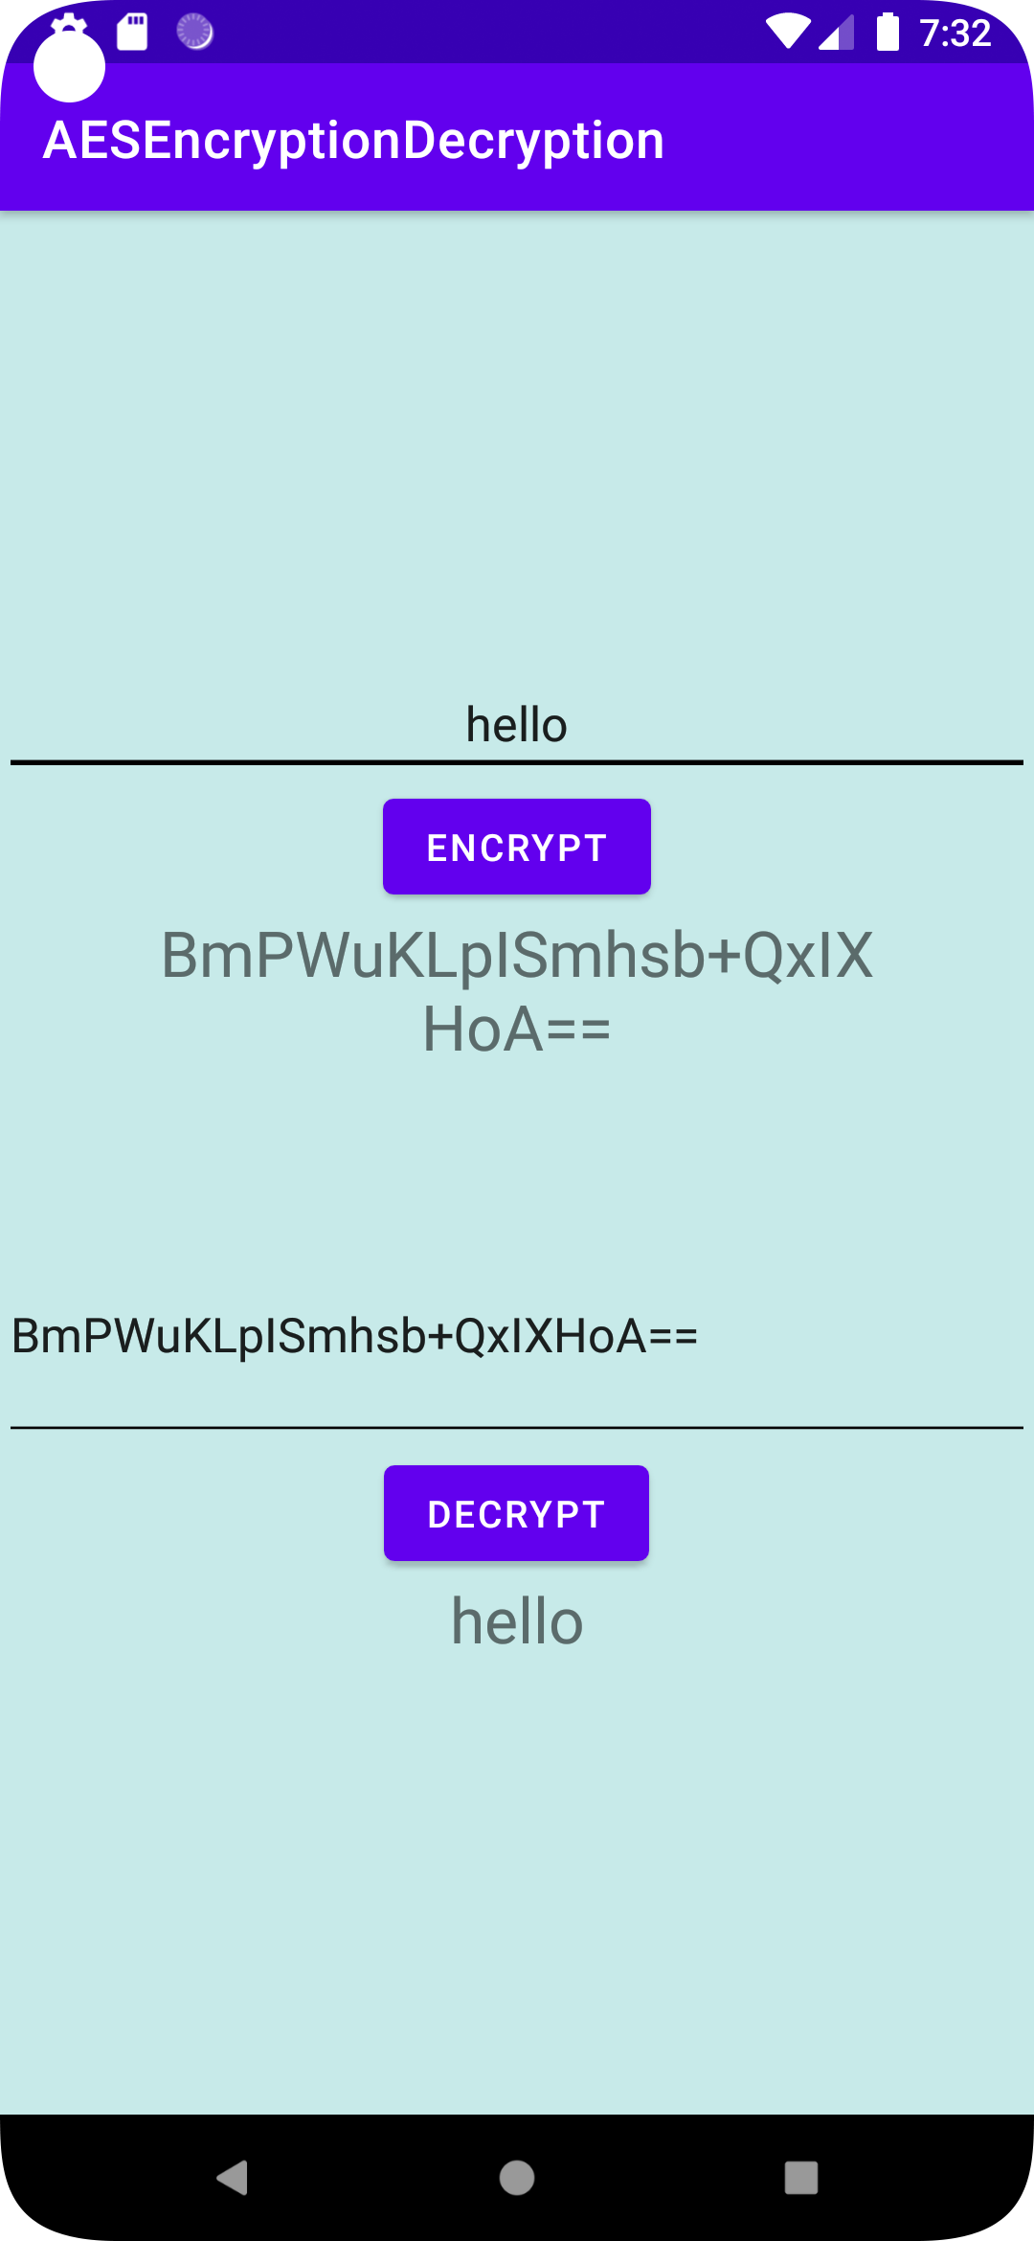
Implementation

Slide 11
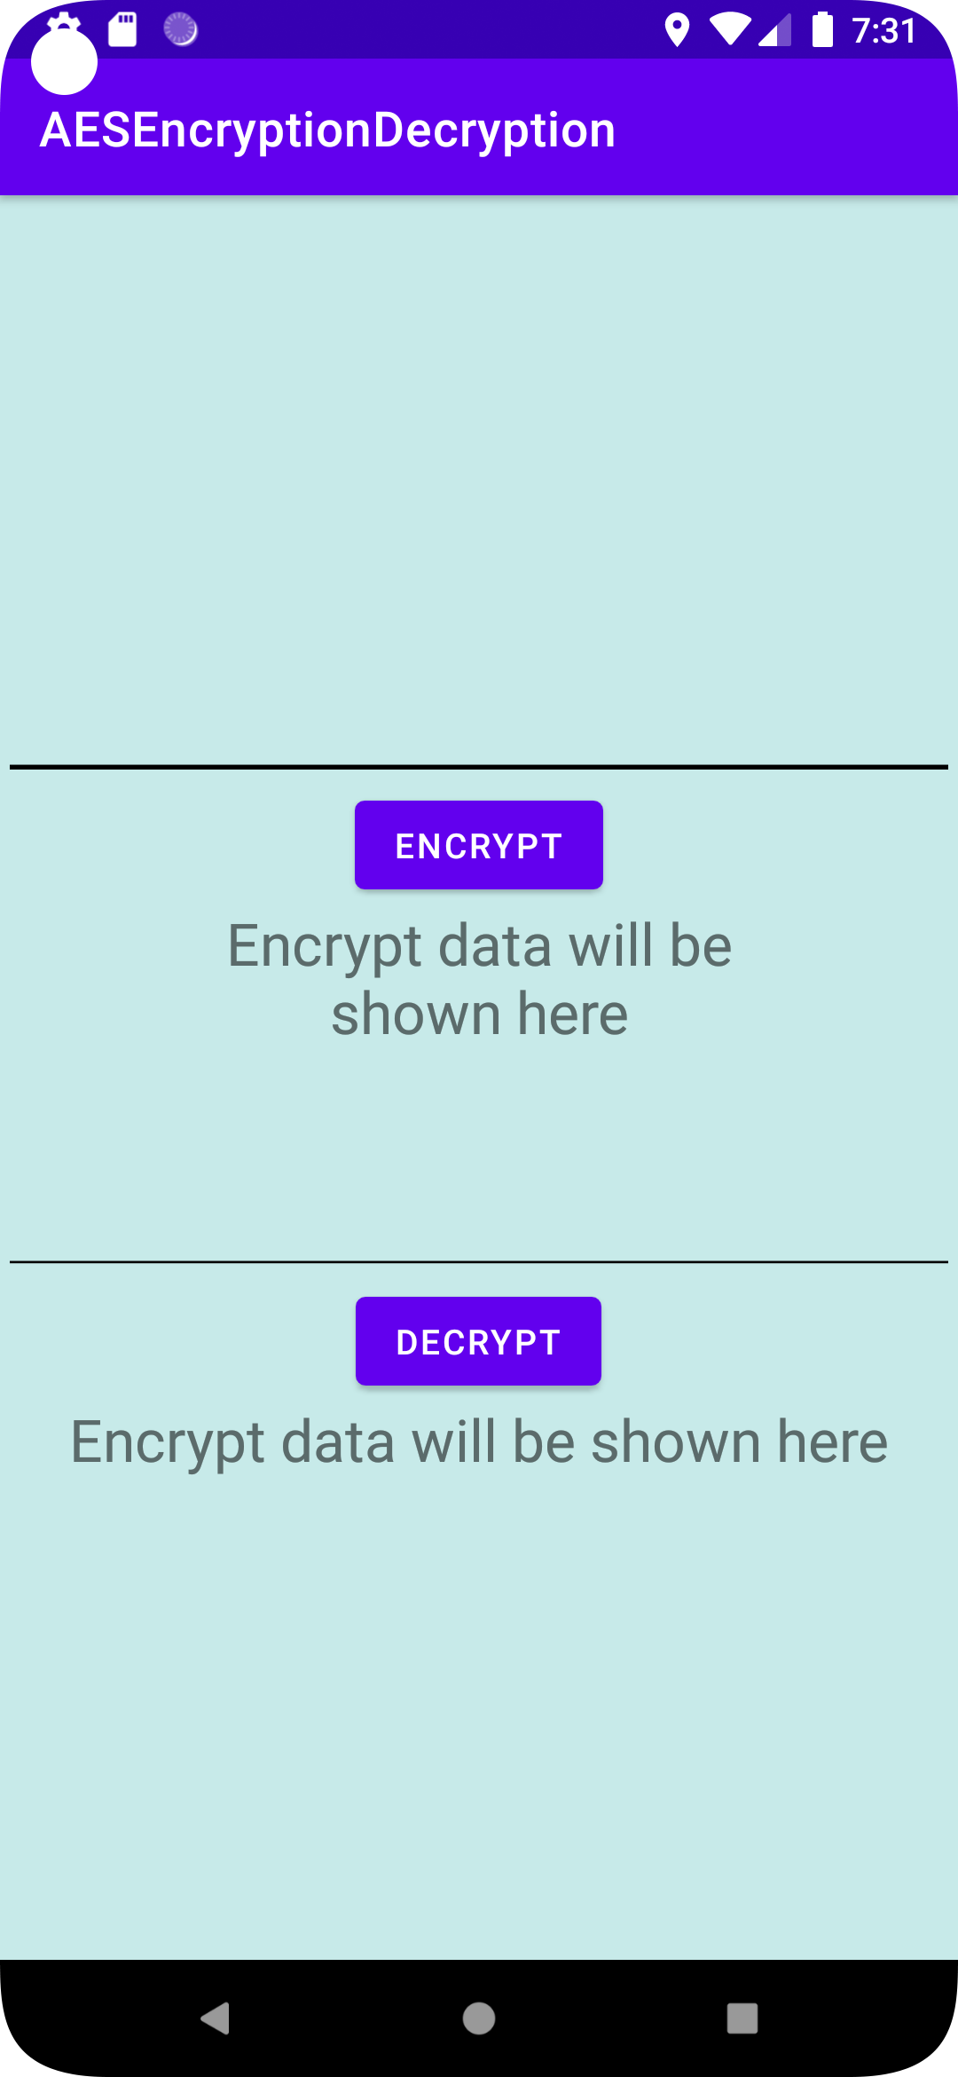
Implementation

Slide 12
Technology Used :
Java
NetBeans IDE
Android Studio
Structured Query Language

Slide 13
Conclusion
Information Access:
  The proposed secure communication system serves as a versatile solution for individuals and professionals.
  The combination of encryption and user-controlled secret keys empowers individuals to take control of their communication privacy
User Satisfaction:
  Present users are positive, comfortable, and satisfied with Encryption experiences.
  Trust is high Due to Algorithm used.

Slide 14
References
Abdullah, Ako Muhamad. "Advanced encryption standard (AES) algorithm to encrypt and decrypt data." Cryptography and Network Security 16.1 (2017): 11.[1]
Tayde, Suchita, and Seema Siledar. "File encryption, decryption using AES algorithm in android phone." International Journel of Advanced Research in computer science and software engineering 5.5 (2015). [2]
Deshpande, Ashwini M., Mangesh S. Deshpande, and Devendra N. Kayatanavar. "FPGA implementation of AES encryption and decryption." 2009 international conference on control, automation, communication and energy conservation. IEEE, 2009. [3]

Slide 15
Thank You...!!

